Slide 1
Board-level testing and
IEEE1149.x Boundary Scan standard
Artur Jutman
artur@ati.ttu.ee
August 2010

Slide 2
IEEE 1149.1 Boundary Scan Standard
Board level testing challenges
Fault modeling at board level (digital)
Test generation for interconnect faults
IEEE 1149.1 Boundary Scan Standard
Application of Boundary Scan

Slide 3
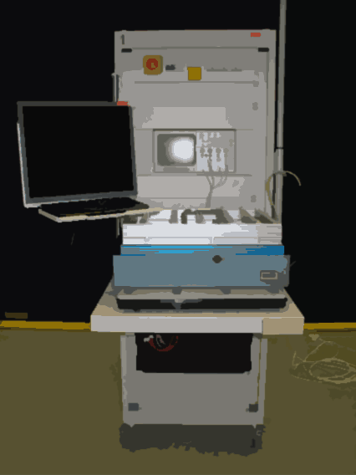
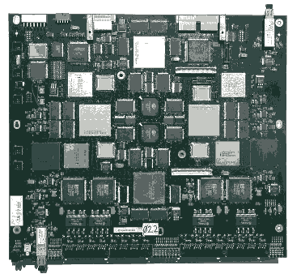
The Challenge of Board Testing
Tested chips placed on board
Only interconnects to be tested!

Source: Intel
Source: Elcoteq

Slide 4
Modeling of Interconnect Faults
Net-level defect types and models
Short faults
Open faults
Delay faults
Noise/crosstalk
Ground bounce
…
static behavior
dynamic behavior

Slide 5
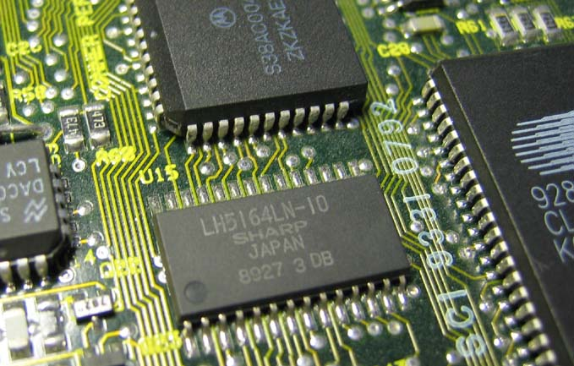
Short Faults
Possible shorts: bond wire, leg, solder, interconnect
Shorts are usually modeled as wired-AND, wired-OR faults

Slide 6
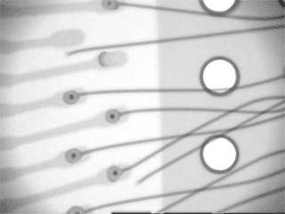
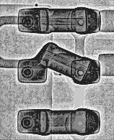
Open Faults
Misplaced bond wire Misplaced component
Possible opens: bond wire, leg, solder, interconnect
Opens usually behave like stuck-at or delay faults

Slide 7
Tri-state connections
Main difference between logic circuits and board-level systems is the way the components are connected.
Typical board-level interconnect uses tri-state logic: logic-0, logic-1, and “high impedance” (switched off) state. Common notation: 0,1,Z.
There are special “enable” signals that control this additional state of the I/O pins.

Slide 8
Tri-state connections
Nets with several drivers
Nets with bi-directional pins

Slide 9
Tri-state net structure
enable
data
pin
pin
data_in
enable
data
pin
data_in

Slide 10
Specific faults in tri-state nets
Driver faults
  stuck-driving fault
  stuck-not-driving fault
  stuck-at fault
Net opens
  stuck-at fault
  delay fault
Net shorts
  zero dominance
    wired AND (mutual 0-dom.)
  one dominance
    wired OR (mutual 1-dom.)
  net dominance
    strong driver fault

Slide 11
IEEE 1149.1 Boundary Scan Standard
Board level testing challenges
Fault modeling at board level (digital)
Test generation for interconnect faults
IEEE 1149.1 Boundary Scan Standard
Application of Boundary Scan

Slide 12
Test Generation Algorithms
?
Open
1
0
Assume stuck-at-0
How many vectors are enough to cover all possible interconnect faults including delays and other dynamic effects?
1
1
0
0
Short
1
0
Assume wired AND
Opens usually behave like stuck-at or delay faults
Shorts are usually modeled as wired-AND or wired-OR

Slide 13
The Counting Sequence
?
Open
00
00
Assume stuck-at-0
What about
opens?
01
01
10
10
Short
11
10
Assume wired AND
Kautz [1] showed in 1974 that a sufficient condition to detect any pair of short circuited nets was that the serial codes must be unique for all nets. Therefore the test length is ⎡log₂(N)⎤

Slide 14
The Modified Counting Sequence
?
Open
001
000
Assume stuck-at-0
Some of the observed error responses are allowed codes.
How to improve the diagnosis?
010
010
011
000
Short
100
000
Assume wired AND
All 0-s and all 1-s are forbidden codes because of open faults. Therefore the final test length is ⎡log₂(N+2)⎤
This method was proposed in 1982 by Goel & McMahon [2]

Slide 15
The True/Complement Code
!
Open
00 11
00 00
Assume stuck-at-0
All-0 and all-1 codes are not forbidden anymore!
01 10
01 10
10 01
10 00
Short
11 00
10 00
Assume wired AND
To improve the diagnostic resolution Wagner proposed the True/Complement Code in 1987 [3].
The test length became equal 2⎡log₂(N)⎤

Slide 16
The True/Complement Code
?
Open
00 11
00 00
Assume stuck-at-0
01 10
01 10
What about delay faults and other dynamic effects?
10 01
10 00
Short
11 00
10 00
Assume wired AND
Important properties of the True/Complement Code are:
there are equal numbers of 0-s and 1-s upon each line
Hamming distance between any two code words is at least 2

Slide 17
Summary of TG Methods
 | Counting | Modified | True/Compl. | Walking | LaMa
 | 000 001 010 011 100 101 110 111 | 001 010 011 100 101 110 | 111 000 110 001 101 010 100 011 011 100 010 101 001 110 000 111 | 10000000 01000000 00100000 00010000 00001000 00000100 00000010 00000001 | 00001 00100 00111 01010 01101 10001 …
Length | ⎡log₂(N)⎤ | ⎡log₂(N+2)⎤ | 2 ⎡log₂(N)⎤ | N | ⎡log₂(3N+2)⎤
Example (N=10000) | 14 | 14 | 28 | 10000 | 15
Hamming distance | 1 | 1 | 2 | 2 | 2
Defects | Shorts | Shorts Opens | Shorts Opens /Delays/ | Shorts Opens /Delays/ | Shorts Opens
Diagnostic Properties | Bad | Bad | Good | Good | Good

Slide 18
More complex case
enable
data
data_in
Open
enable
Driver Fault
data
Short
data_in
data
data_in

Slide 19
Industrial approach to board test
Visual inspection
Optical/x-ray inspection
Smoke test ;-)
Power distribution test
Structural test
  in-circuit test (ICT)
  Boundary Scan (BS)
  Test Processors/Cores (BIST)
Functional test (FT)

Slide 20
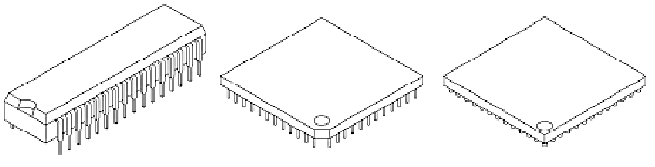
Limitations of the Nail Probing
Packaging
styles
DIP PGA BGA
Multilayer
boards
chip
PCB
conductive layers

Slide 21
Test Access Methods: Usage Trends
Test access by different
test methods
Boundary Scan
AOI and AXI
Functional Testing
Flying Probe
In-Circuit Testing
1980
1990
2000
2010

Slide 22
IEEE 1149.1 Boundary Scan Standard
Board level testing challenges
Fault modeling at board level (digital)
IEEE 1149.1 Boundary Scan Standard
Test generation for interconnect faults
Application of Boundary Scan

Slide 23
IEEE 1149.1 Boundary Scan: History
Early 1980’s – problem of test access to PCBs via “bed-of-nails” fixture
Mid 1980’s – Joint European Test Action Group (JETAG)
1986 – US companies involved: JETAG -> JTAG
1990 – JTAG Test Port became a standard [4]:
IEEE Std. 1149.1: Test Access Port and Boundary Scan Architecture comprising serial data channel with a 4/5-pin interface and protocol

Slide 24
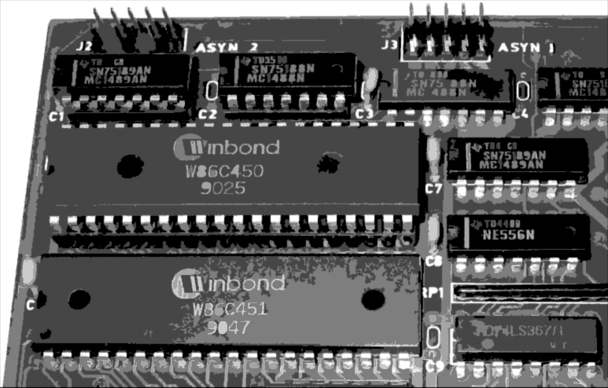
Test Access Via Boundary Scan
TDI
TDO

Slide 25
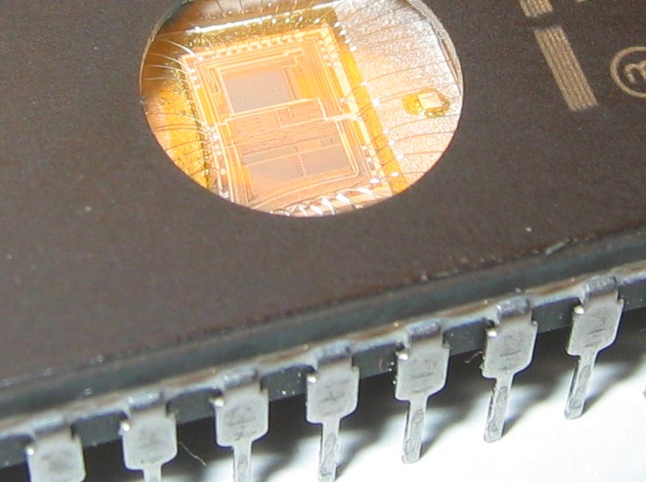
Test Access Via Boundary Scan

Slide 26
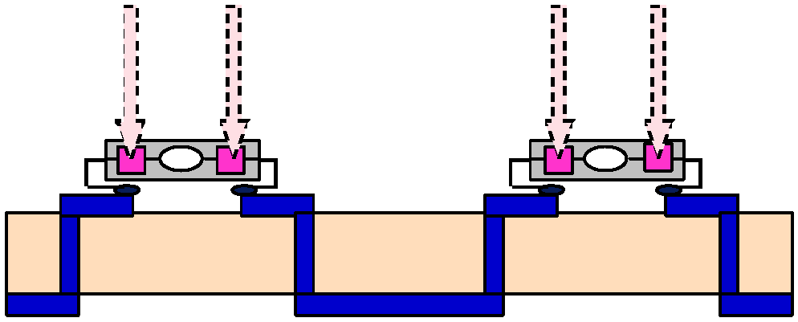
Test Access Via Boundary Scan
Driver
Sensor
Virtual nails
Defects covered:
driver scan cell, driver amp, bond wire, leg, solder, interconnect, solder, leg, bond wire, driver amp, sensor scan cell

Slide 27



























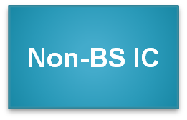



Test Access Via Boundary Scan
I/O
TAP
port
ADDR
DATA
CONTROL
A
D
C
ADDR
DATA
CTRL
I/O
Printed Circuit Board

Slide 28
Boundary Scan basics
Pin
Pin
Core Logic
Core Logic
BScan Cell
TDI
TAP
controller
TDO
TCK
TMS
... some extra
logic is needed
for Test Access
Non-BScan Device
BScan Device
For describing Boundary Scan devices BSDL (Boundary Scan Description Language) models are used

Slide 29
IEEE 1149.1 Device Architecture
BS Cells
Core
Logic
TDI
(Test Data In)
MUX
MUX
TDO
Bypass
(Test Data Out)
Identification
Register
Instruction
Register
(Test Mode Select)
TMS
TAP
Controller
TCK
(Test Clock)
Test Reset
(Optional)

Slide 30
Typical Boundary Scan Cell (BC_1)
BC_1 is used both at input and output pins
Scan Out
(SO)
Mode
Data In
(PI)
0
1
Data Out
(PO)
Capture
Scan Cell
Update
Hold Cell
0
1
D Q
D Q
Clk
Clk
Scan In
(SI)
ShiftDR
ClockDR
UpdateDR

Slide 31
Boundary Scan Instructions
Instruction
SAMPLE /PRELOAD
EXTEST
BYPASS
IDCODE
INTEST
CLAMP
HIGHZ
RUNBIST
USERCODE
Status
Mandatory
Mandatory
Mandatory
Optional
Optional
Optional
Optional
Optional
Optional

Slide 32
Boundary Scan Working Modes
SAMPLE/PRELOAD instruction – sample mode
Get snapshot of normal chip output signals
Core
Logic
ShiftDR
SO
Mode
ShiftDR
SO
Mode
0
1
0
1
0
1
D Q
D Q
0
1
D Q
D Q
Clk
Clk
Clk
Clk
SI
ClockDR
UpdateDR
SI
ClockDR
UpdateDR
Core
Logic
Get snapshot of normal chip output signals
TDI
TDO

Slide 33
Boundary Scan Working Modes
SAMPLE/PRELOAD instruction – preload mode
Shift out snapshot data and shift in new test data to be used later
Core
Logic
ShiftDR
SO
Mode
ShiftDR
SO
Mode
0
1
0
1
0
1
D Q
D Q
0
1
D Q
D Q
Clk
Clk
Clk
Clk
SI
ClockDR
UpdateDR
SI
ClockDR
UpdateDR
Core
Logic
Shift out snapshot data and shift in new test data to be used later
TDI
TDO

Slide 34
Boundary Scan Working Modes
EXTEST instruction – driving and sensing:
Test off-chip circuits and board-level interconnections
Core
Logic
ShiftDR
SO
Mode
ShiftDR
SO
Mode
0
1
0
1
0
1
D Q
D Q
0
1
D Q
D Q
Clk
Clk
Clk
Clk
SI
ClockDR
UpdateDR
SI
ClockDR
UpdateDR
Test off-chip circuits and board-level interconnections
Core
Logic
TDI
TDO

Slide 35
Boundary Scan Working Modes
EXTEST instruction – shifting
Shift out snapshot data and shift in new test data to be used later
Core
Logic
ShiftDR
SO
Mode
ShiftDR
SO
Mode
0
1
0
1
0
1
D Q
D Q
0
1
D Q
D Q
Clk
Clk
Clk
Clk
SI
ClockDR
UpdateDR
SI
ClockDR
UpdateDR
Core
Logic
Shift out snapshot data and shift in new test data to be used later
TDI
TDO

Slide 36
Typical BS Interconnect Test Flow
BS mode | Test bus actions | Test data manipulations | Test
PRELOAD | IRshift + DRshift | Loading the first test vector to BS register (vector includes control/disable values for other devices on the bus) | Vector 1 loaded
EXTEST | IRshift + DRshift | 1. Applying vector 1 to the DUT 2. Capturing test responses from DUT in BS reg. 3. Reading back test responses and loading new test vector to BS register | Vector 1 applied and analyzed
EXTEST | DRshift | 1. Applying vector 2 to the DUT 2. Capturing test responses from DUT in BS reg. 3. Reading back test responses & and loading new test vector to BS register | Vector 2 applied and analyzed
EXTEST | DRshift | 1. Applying vector N to the DUT 2. Capturing test responses from DUT in BS reg. 3. Reading back test responses | Vector N applied and analyzed
Time N test vectors: (N+1) DRshifts + 2 IRshifts ≈ (N+1) DRshifts

Slide 37
Boundary Scan Working Modes
BYPASS instruction:
Bypasses the corresponding chip using 1-bit register
TDI
D Q
To TDO
Shift DR
Clock DR
Clk
Core
Logic
Core
Logic
Core
Logic
TDI
TDO
BYPASS
SAMPLE
BYPASS
Similar instructions: CLAMP, HIGHZ

Slide 38
Boundary Scan Working Modes
IDCODE instruction:
Connects the component device identification register serially between TDI and TDO in the Shift-DR TAP controller state
Allows board-level test controller or external tester to read out component ID
Required whenever a JEDEC identification register is included in the design
TDI
TDO
Version
Part Number
Manufacturer ID
1
4-bits
Any format
16-bits
Any format
11-bits
Coded form of JEDEC

Slide 39
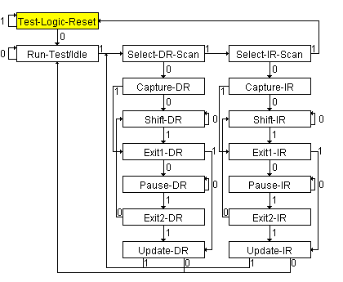
TAP Controller State Diagram
DR Branch
IR Branch
The TAP state diagram has two main branches and two idle states.
Shift IR and Shift DR states are used to insert instructions and test data into the BS device. These are the most important states.
The number of states is exactly 16 (to avoid some undefined states)
TMS signal is used to move through the states

Slide 40
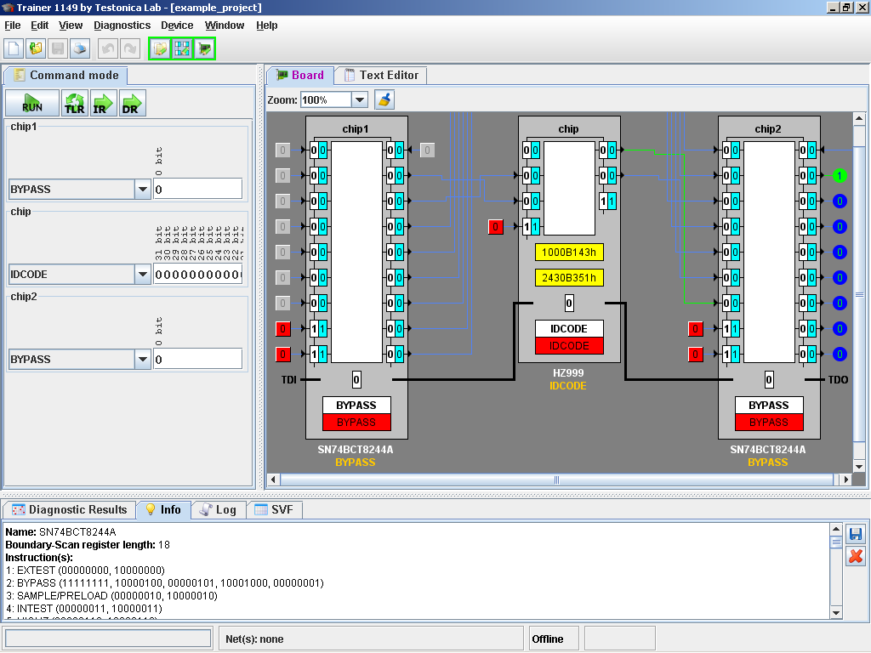
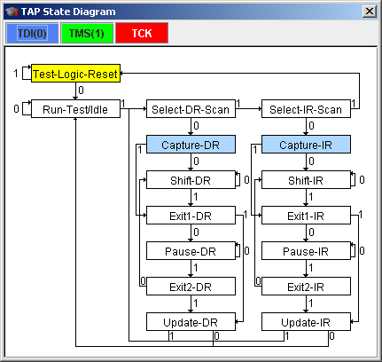
Boundary Scan in Motion (Demo)
http://www.testonica.com

Slide 41
IEEE 1149.1 Boundary Scan Standard
Board level testing challenges
Fault modeling at board level (digital)
IEEE 1149.1 Boundary Scan Standard
Test generation for interconnect faults
Application of Boundary Scan

Slide 42
BSC implementation
One or more BSC at each system input or output of on-chip system logic (core logic)
BSC may be connected to chip-internal signals
No BSC on:
  TAP pins (TCK, TMS, TDI, TDO, TRST)
  Compliance Enable Pins
  Non-digital pins (e.g. analog pins, power pins)
No logic between BSC and I/O pin it is connected to (a buffer is allowed)

Slide 43
BSC implementation
VCC
Analog
Core Logic
(digital)
BScan Cell
+
–
GND
TDI
TAP
controller
TDO
TCK
TMS
Notes:
A BScan Cell can actually combine several cells per pin, depending on pin type (e.g. 2 cell output, 3-cell bi-directional, etc.).

Slide 44
BSC implementation
Input:
24
on-chip
system logic
Pin

Slide 45
BSC implementation
2-state output:
on-chip
system logic
7
Pin

Slide 46
BSC implementation
3-state output:
“control”
6
on-chip
system logic
“data”
5
Pin
Driver

Slide 47
BSC implementation
Bi-directional, 2-cell:
“control”
6
on-chip
system logic
“data”
5
Pin
Driver

Slide 48
BSC implementation
Bi-directional, 3-cell:
“control”
2
“out”
on-chip
system logic
1
Pin
Driver
“in”
0

Slide 49
BSC implementation
3-state outputs, shared control cell:
“control”
4
“data”
on-chip
system logic
3
Pin
Driver
2
Pin
Driver

Slide 50
Board-level Test using Boundary Scan (in theory)
JTAG connector
Board (UUT)
Interconnect
Logic
Interconnect
Logic
TDI
TMS
TAP
TAP
TAP
TCK
TDO
Infrastructure test (generated by using BSDL models)
Interconnect test (BSDL models + interconnection netlist)

Slide 51
Board-level Test using Boundary Scan
Infrastructure test
Interconnect test
  One needs to specify behavioral models for non-BS components to get acceptable test coverage
  No standard description format exists
Additional tasks:
Cluster logic test – semi-automated
RAM Test
External connectors test
LED or display test (can be assisted by a camera/sensor)
FLASH test/program/read ID – in-system programming

Slide 52
Board-level Test using Boundary Scan
POWER
JTAG
Microprocessor
PLD
RAM
Flash
Clock generator
Cluster logic
Buffers/MUXes
Pull-up/Pull-down resistors
Jumpers
D/A converter
External connectors
(analog and digital)
RAM
TDI
LEDs
A
A
µP
D
D
C
C
(RAM)
D
CLK
A
TDO
Flash
RS232
A
D
C
C
TDI
(FLASH)
PLD
CLK
TDO
Jumpers
UUT
CLUSTER

Slide 53
Interconnect Test through Clusters
OE 1
BScan
IC 1
Buffer
BScan
IC 2
IN 2
3 OUT
B
A
C
BScan
IC 3

Slide 54
RAM / Flash Test
Chip select
BScan
IC 1
BScan
IC 2
RAM 1
RAM 2
Flash
To generate test:
Specify constraints that will select only one device
RAM/Flash model in special format that provides description of read/write protocol

Slide 55
Cluster Logic Test (Manual)
BScan
IC 1
&
BScan
IC 2
1
Truth table
000 0
001 1
010 1
…
111 1
Provide cluster’s truth table

Slide 56
External connectors
Boundary Scan
Controller
JTAG
Board
BScan
IC
Matching Board or
I/O module
Only interconnect test will be performed!
The real protocol of external connector is not tested

Slide 57
Boundary Scan Test Development Typical workflow
CAD Netlist
Importer
Parsed
Netlist
Constraints
Description of boards come in different formats (depends on CAD system used by designer) ➔
CAD Import is the first step
Common problems:
Netlist doesn’t fully correspond to board
CAD Importer does not work correctly

Slide 58
Boundary Scan Test Development Typical workflow
CAD Netlist
Importer
Parsed
Netlist
Classifier
Constraints
BSDL Models
Parser
Models for non-BS components (buffers, ram, flash, etc)
Scan-path configuration
Netlist with
drive/sense constraints
Common problems:
BSDL file is not available
Model of non-BS component is absent in the library

Slide 59
Boundary Scan Test Development Typical workflow
CAD Netlist
Importer
Parsed
Netlist
Classifier
Constraints
BSDL Models
Parser
Models for non-BS components (buffers, ram, flash, etc)
Scan-path configuration
Functional models for RAM/Flash
Netlist with
drive/sense constraints
Interconnect
ATPG
RAM Test, Flash Test/Program Generator
Constraints
Compiled Test Program
Test Coverage Report
Compiled Test Data

Slide 60
IEEE 1149.1 Summary
Boundary Scan Standard has become absolutely essential:
  No longer possible to test printed circuit boards with bed-of-nails tester
  Not possible to test multi-chip modules at all without it
  Supports BIST, external testing with Automatic Test Equipment, and boundary scan chain reconfiguration as BIST pattern generator and response compacter
  Now getting widespread usage

Slide 61
Boundary Scan – Evolution
1149.4 – Mixed-Signal Test Bus (testing analog signals)
1149.6 – Boundary-Scan Testing of Advanced Digital Networks (testing high speed links)
1149.7 – CJTAG – Compact JTAG (debug)
1149.8.1 – Sensing using capacitive plate
P1687 – IJTAG – Internal JTAG (component testing, BIST)
1500 – Embedded Core Test (SoC testing)
1532 – In-System Configuration of Programmable Devices
P1581 – Static Component Interconnection Test Protocol and Architecture (memory-to-BS_chip links testing)
5001 – NEXUS – Global Embedded Processor Debug Interface (SW development, debug, and emulation)

Slide 62
What to look further
Leading BScan companies:
  Goepel Electronic (http://www.goepel.com/)
  ASSET Intertech (http://www.asset-intertech.com/)
  JTAG Technologies (http://www.jtag.com/)
Training software:
  Trainer 1149 by Testonica Lab (http://www.testonica.com/1149/download.htm)
  Scan Coach by Goepel Electronic (http://www.goepel.com/content/html_en/index.php?site=bs_BScanCoach)
  Scan Educator by Texas Instruments (http://focus.ti.com/docs/toolsw/folders/print/scan_educator.html)
Literature:
  Kenneth P. Parker, The Boundary-Scan Handbook
  Lecture notes by Ben Bennetts
Active Universities:
  Porto, Portugal
  Tallinn, Estonia
  Liberec and Prague, Czech Republic
  Lubljana, Slovenia

